Slide 1
Environmental, Social, and Governance (ESG) and you!
Can you invest on stocks based on their sustainability ratings?

Slide 2
Agenda
Overview
Database Framework
Our Team
ESG Intro
The Analysis
Our Journey
Our Questions
Machine Learning
References
Data Source
The Dashboard

Slide 3

Overview
Here at ESG Consultants, we are building a machine learning module to:
Help you invest in ESG.
Determine if ESG scores effect investor’s confidence.
Notes:
Deliverable: Selected topic
Presenter: Sachin
Speaker Notes:

Slide 4
What is ESG and why is it important?
Notes:
Deliverable: Selected topic
Presenter: Sachin
Speaker Notes:

Slide 5

What is ESG?
Set of standards used to measure a company’s adherence to environmental, social and corporate governance standards.
Notes:
Deliverable: Reason the topic is selected
Presenter: Sachin
Speaker Notes:

Slide 6



Why is ESG Important?
Social
Governance
Environment
E
Health & Safety
Human Rights
G
S
Natural resources
Climate risk
Ethical standards
Shareholder rights
Notes:
Deliverable: Reason the topic is selected
Presenter: Sachin
Speaker Notes: Environment (E): 56% of population lives in cities and towns and account for 70% of CO₂ emissions by 2050 70% will live in towns and cities. The global temperature will rise by 1.5◦ C if we have Net Zero Emissions of CO₂ by 2050 otherwise may be more than 3.5◦ C.
We want to know whether about the company’s energy use , waste, pollution, natural resource conservation, treatment of animals etc.
Social (S): The global population is 8 billion set to rise to 8.5 billion by 2030 and 9.7 billion by 2050. Community Relations and Human Rights, Workplace Health and Safety, Diversity and Inclusion cannot be overlooked.
We want to know company’s does a company donate a portion to local communities , and all points mentioned above in grey.
Governance(G): With a population of more than 8.5 billion and global temperatures rising the need for innovation in Policy and Code of Conduct, Supply Chain Management, CSR initiatives is a must for any company.
Company uses accurate and transparent accounting methods, stockholder’s allowed to vote on important issues and all mentioned in grey above.

Slide 7
Questions that we hope to answer ?
Is there a correlation between stock performance and ESG ratings?
What are the red flags that affect ESG ratings?
1
4
How does ESG scores affect a company’s bottom line?
How can you invest in ESG?
2
5
Have companies adapted better to ESG based on industry?
3
Notes:
Time check:
Deliverable: Questions the team hopes to answer with the data
Presenter: Sachin
Speaker Notes:

Slide 8


The Data Source
The Just 100 (Forbes)
ESG ratings
Yahaoo! Finance
Historical stock data
Notes:
Time check:
Deliverable: Description of the source of data
Presenter: Sachin
Speaker Notes:
Forbes:
Sustainability parameters like environment, social, even public sentiment for various companies which have been rated highly based on their ESG initiatives.
Performance metrics like RoE, RoA, revenue
Yahoo!
Five years of historical stock price data to predict the stock prices using machine learning.

Slide 9
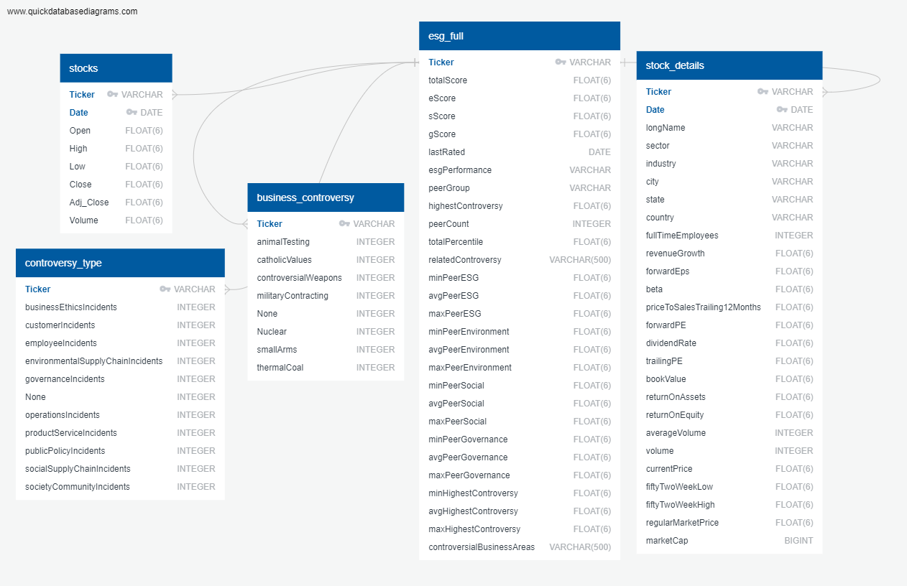
Database
Framework
Notes:
Time check:
Deliverable: Description of the data exploration phase of the project
Presenter: Sachin
Speaker Notes:
Our Database contains:
stocks
controversy_type
business_controversy
esg_full
stock_details

Slide 10

The Analysis
Data Exploration
Results
ESG scores
Reg Flags
Stock Analysis
Notes:
Time check:
Deliverable: Result of the analysis
Presenter: Yicong
Speaker Notes:

Slide 11
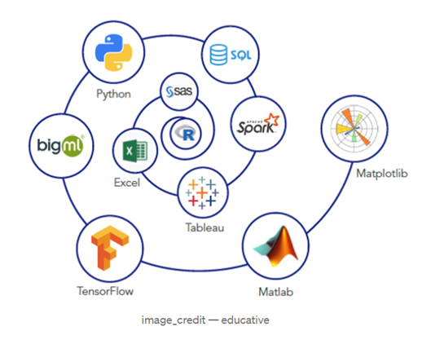
Tools Used
01 | Python
02 | APIs
03 | AWS, Postgres, SQLAlchemy
03 | FBProphet & SKLearn
03 | Tableau
Notes:
Deliverable: Description of the source of data
Presenter: Yicong
Speaker notes:
Python and libraries like pandas, numpy, plotly, seaborn for EDA.
Finance API’s like yfinance and yesg for data extraction.
fbprophet and sklearn for machine learning
AWS RDS Postgres, sqlalchemy for database connection
Tableau for visualization

Slide 12
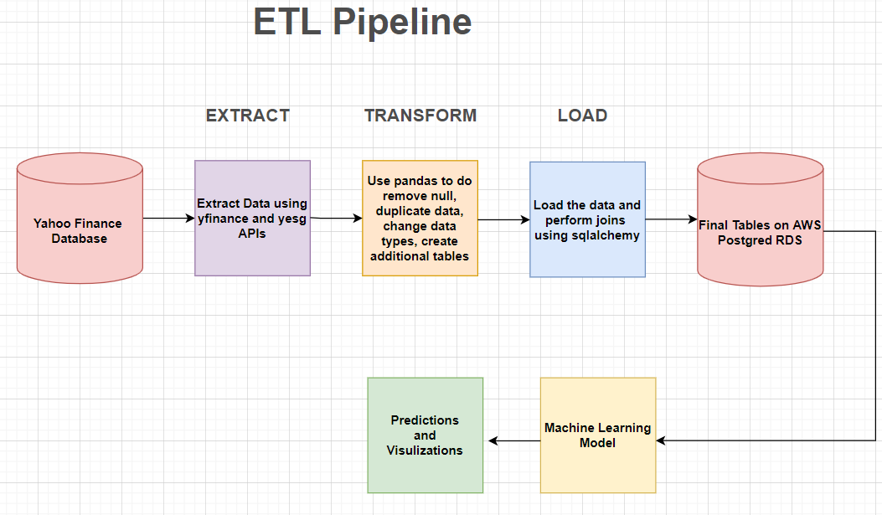
Data Exploration
Primary tools used in the project
Python
Finance API
SQL
AWS RDS Postgres
Tableau
Notes:
Deliverable: Description of the data exploration phase of the project
Presenter: Yicong
Speaker Notes:

Slide 13
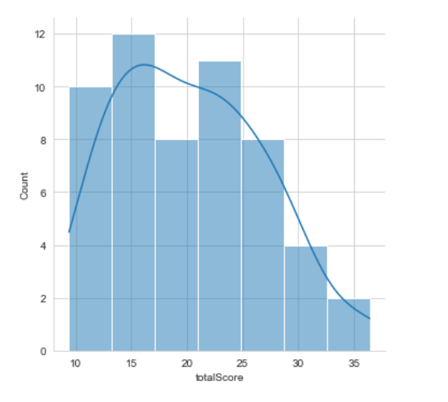
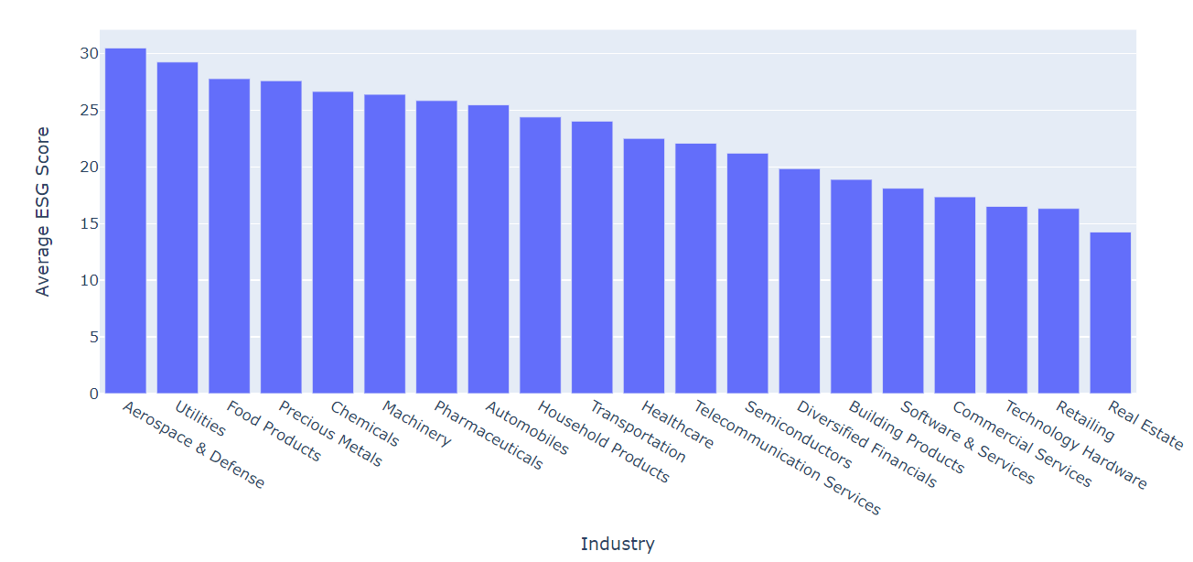
ESG scores distribution
Notes:
Deliverable: Result of the analysis
Presenter: Yicong
Speaker Notes:

Slide 14
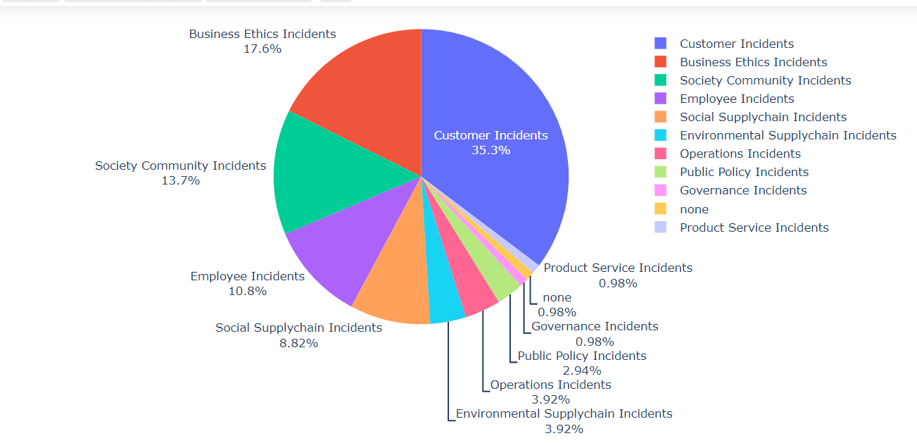
Controversies(incidents) to influence the ESG
Notes:
Deliverable: Result of the analysis
Presenter: Yicong
Speaker Notes:

Slide 15
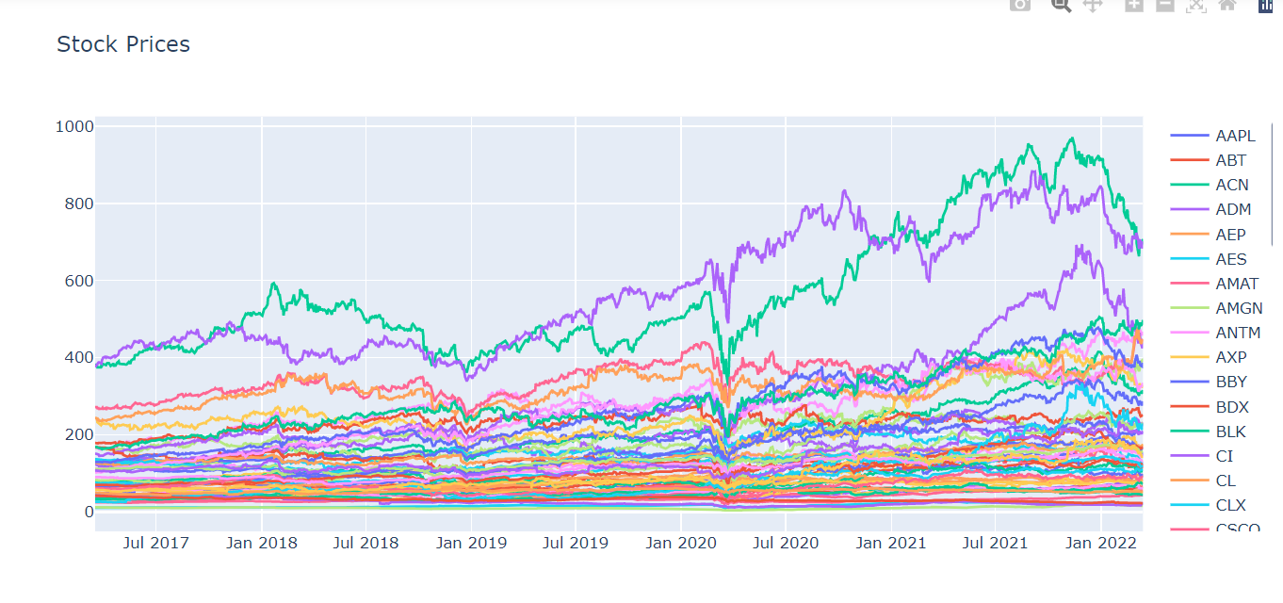
Stocks Prices In the Past Five Year
Notes:
Deliverable: Result of the analysis
Presenter: Yicong
Speaker Notes:

Slide 16

Deliverables

Slide 17

Machine Learning
Stock Predictions
Investor Confidence
Notes:
Time check: 3:30
Deliverable: Result of the analysis
Presenter: Yicong
Speaker Notes:

Slide 18
Machine Learning for Stock prediction
Our first model was linear regression which could not predict stocks beyond a few days due to trends and non-linearity, so finally fbprophet was chosen
Benefits:
It does not require much prior knowledge of forecasting time series data
Based on an additive model where non-linear trends are fit with yearly, weekly, and daily seasonality, plus holiday effects.
Prophet is robust to missing data and shifts in the trend, and typically handles outliers well.
Limitations:
Prophet is generally recommended only for time series where the only informative signals are trends, and the residuals are just noise.
There are other models like ARIMA outperform Prophet when trends are not too important.
Notes:
Presenter: Sucharita To make people start doing ESG investing – we do an ML Stock predictions mode
First linear regression but it cannot predict beyond few days , cannot handle non linear data having trends/seasonality
facebook prophet doesn’t need prior knowledge in time series , goo for trends but for exact buy/sell sigmals ARIMA /SARIMA would be better.

Slide 19
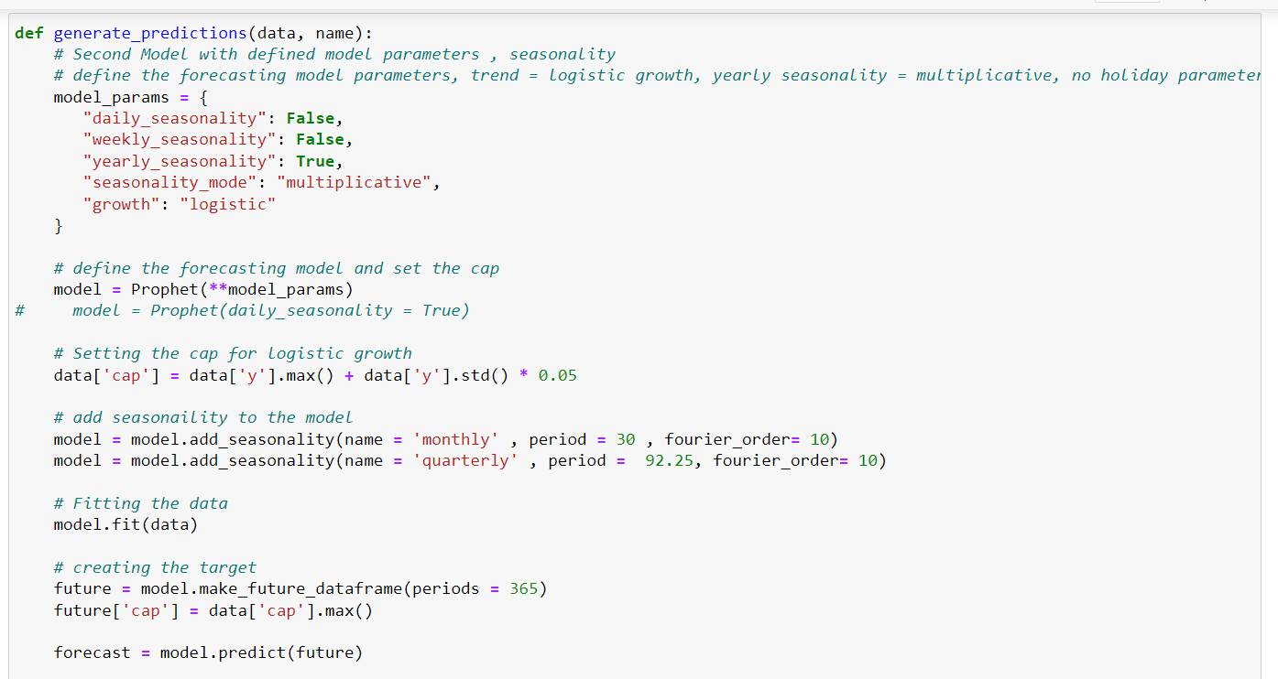
fbprophet Model
Notes:
You can set seasonality, holidays , growth as user defined parameters.
fourier order – how quickly seasonality changes. seasonality mode –multiplicate means change in seasonality is not same every time.

Slide 20
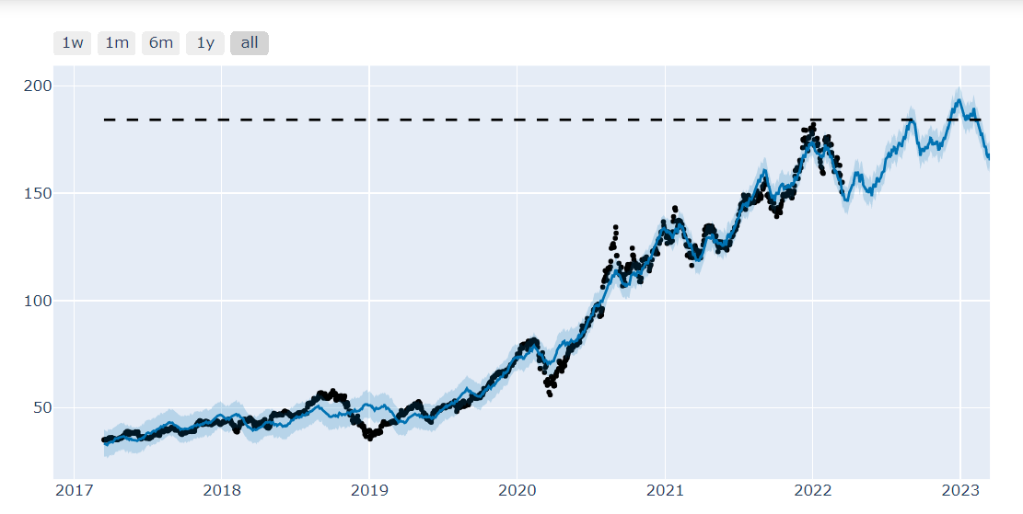
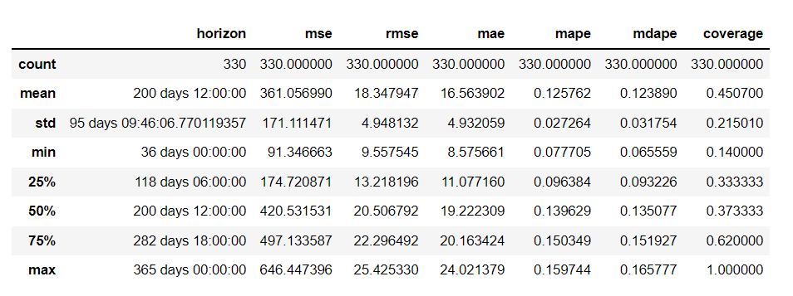
fb prophet performance
Plot for Apple stock
Apple stock performance for fbprophet
Notes:
Presenter: Sucharita
You can see the performance of fb prophet for apple actual from 2017 to March 2022, forecast till 2023.
You can see the Mean absolute percentage error is 12 % and rmse is 18.35

Slide 21
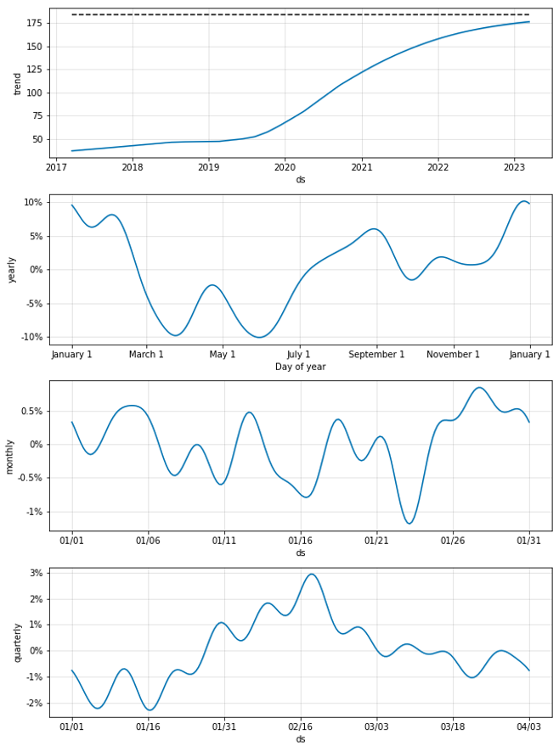
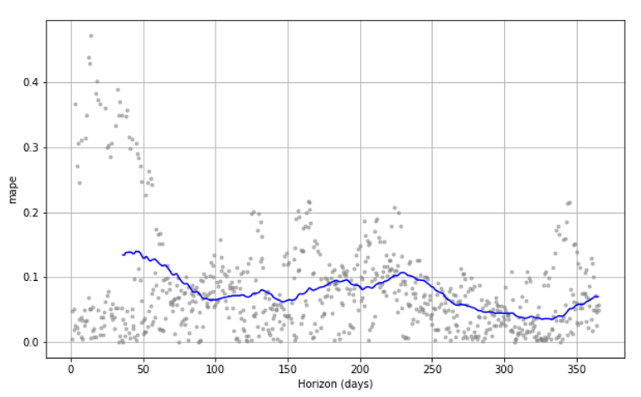
Apple - Forecast for AAPL stock Apple - Mean absolute percentage error(MAPE)
Notes:
Presenter: Sucharita
Reduce MAPE to below 10% by setting holidays , changing seasonality configurations etc.
Average mape for all 55 stocks is: 0.15319351039177415
fbprophet: to find out the accuracy of the model , Making 3 forecasts with cutoffs between 2020-03-20 00:00:00 and 2021-03-15 00:00:00

Slide 22
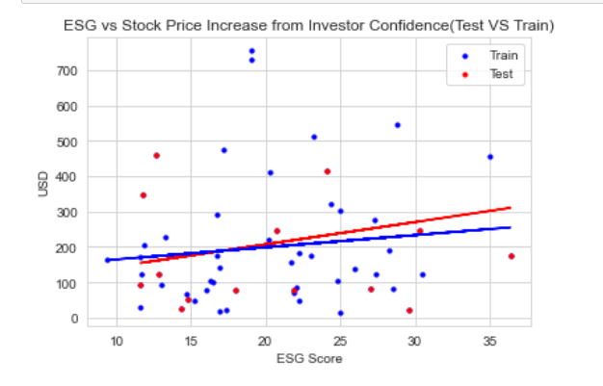
Things to do differently
ESG vs. stock price correlation:
Only 55 data points , historical esg data not free so model was discarded.
Could have collected esg data from 100 company per day during project to have 2500 data points.
P-value: 0.349886
Equation: Difference = 3.4344*ESG + 130.501
R-squared: .017
Notes:
Presenter: Sucharita The R2 was a dismal .017 because the 55 datapoints is too less. Quandl and Bloomberg have historical ESG data but they are not freely available . Only latest ESG data is freely available. We would have gone for 5000 stocks irrespective of the stocks for prediction and worked out this model.

Slide 23
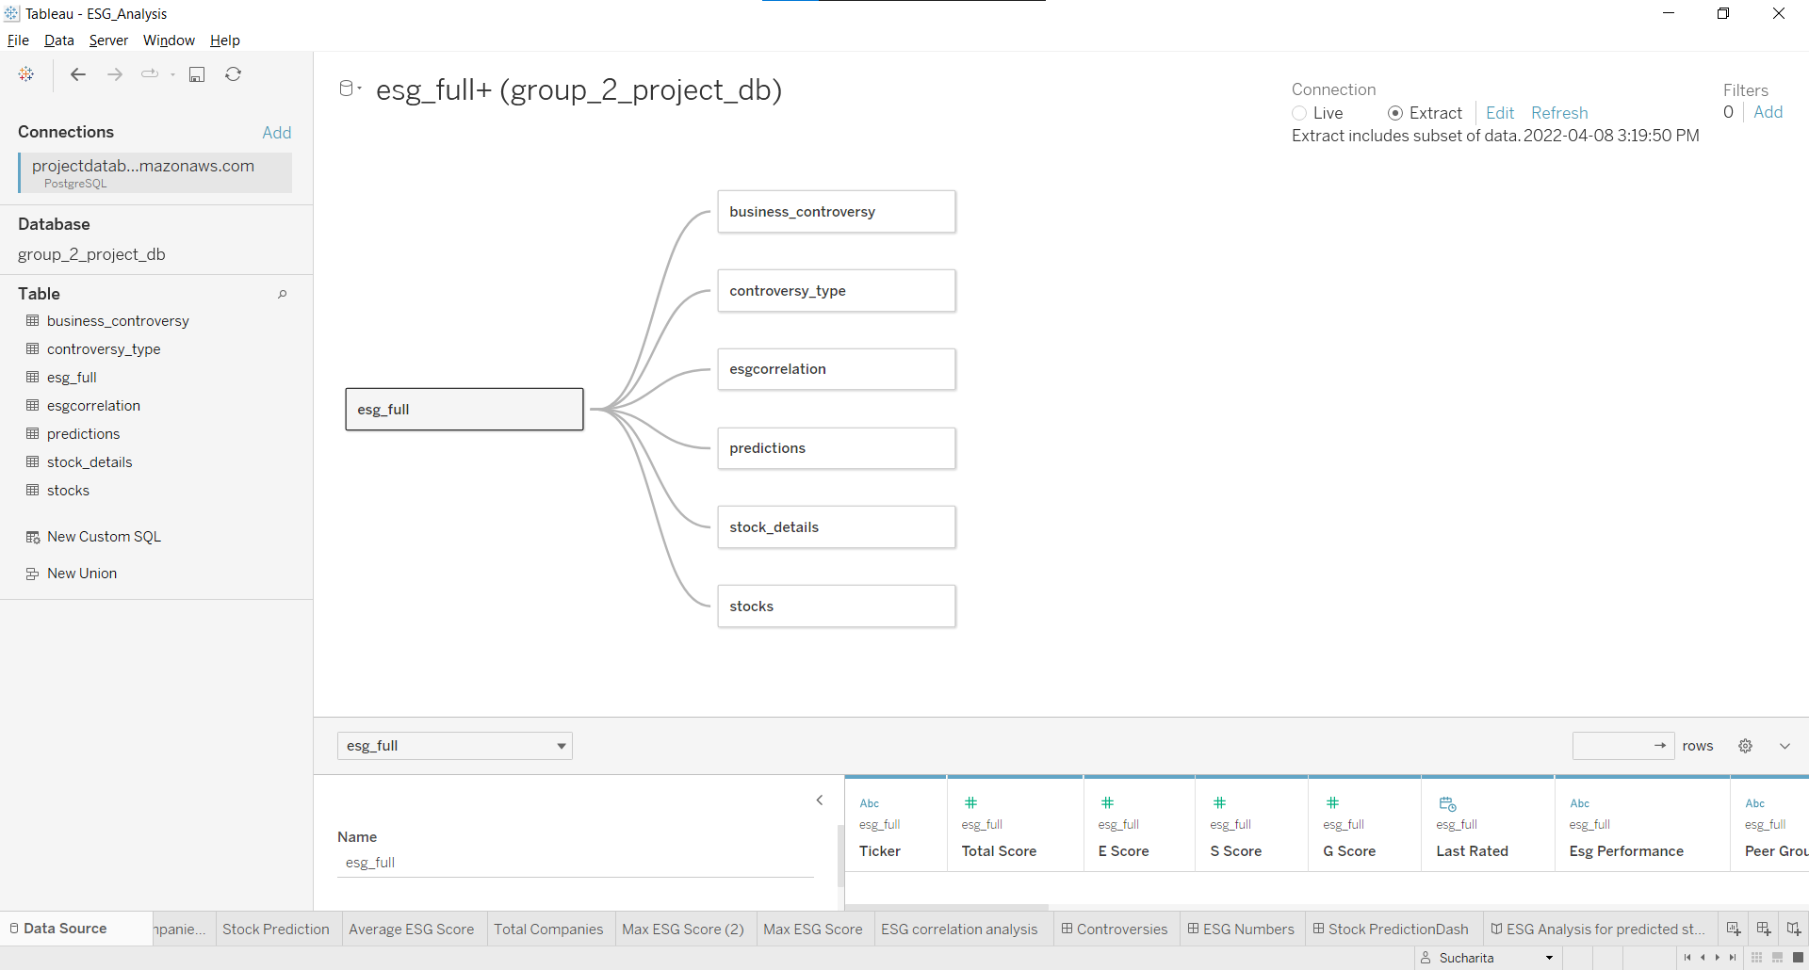
Tableau Data Source

Slide 24
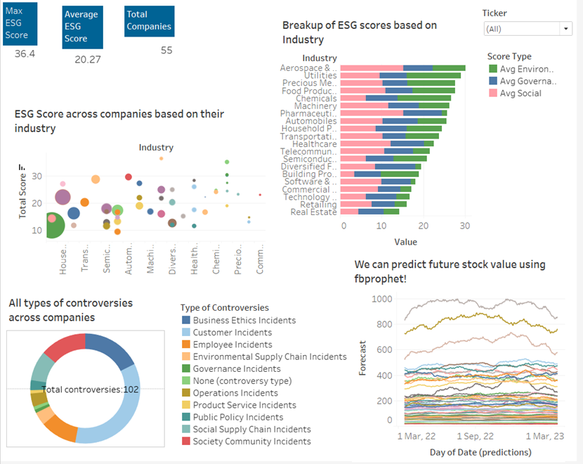
Interactive Demo
Switch to Demo
Notes:
Time check:
Deliverable: Demo of interactive dashboard
Presenter: Monica
Call out: if Demo doesn’t work - continue via next 5 slides
Speaker Notes:
Our interactive dashboard highlights the following areas:
ESG score vs RoE (bubble)
ESG score by industry (bar)
Red flags (# of incidents) by type
Stock performance over time

Slide 25

The Dashboard
Why Tableau?
DB Integration
Simple & Clean
Interactive
Notes:
Time check: 5:40
Deliverable: Result of the analysis
Presenter: Monica
Speaker Notes:
Tableau offers integration with our database increasing longevity and reusability
Tableau provides clean and easy ways to visualize our data
Storyboards allow our users to interact with our dashboard to drill down and learn more

Slide 26
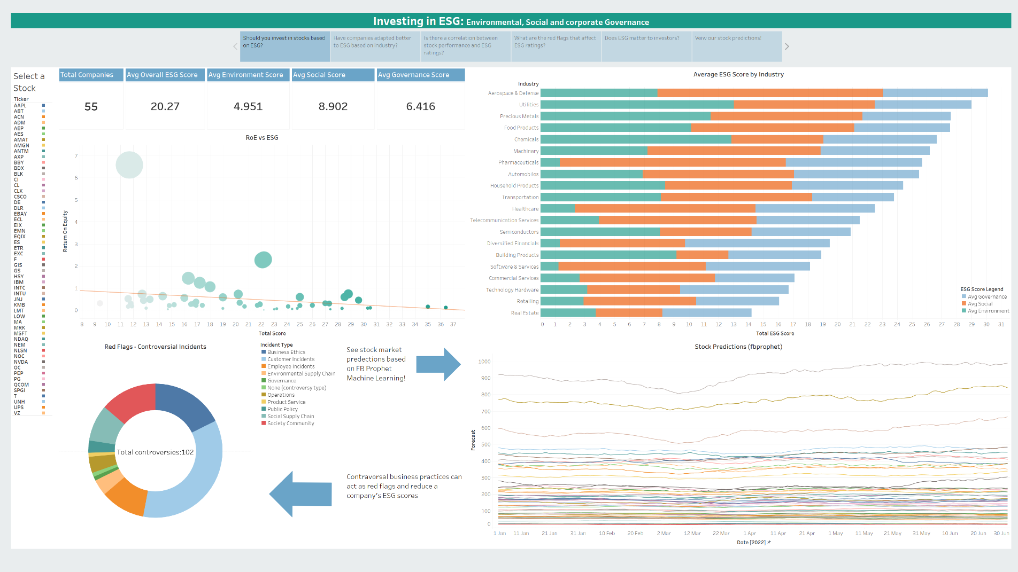
Notes:
Deliverable: Demo of interactive dashboard
Presenter: Monica
Call out: if Demo doesn’t work - continue via next 5 slides
Speaker Notes: see demo

Slide 27
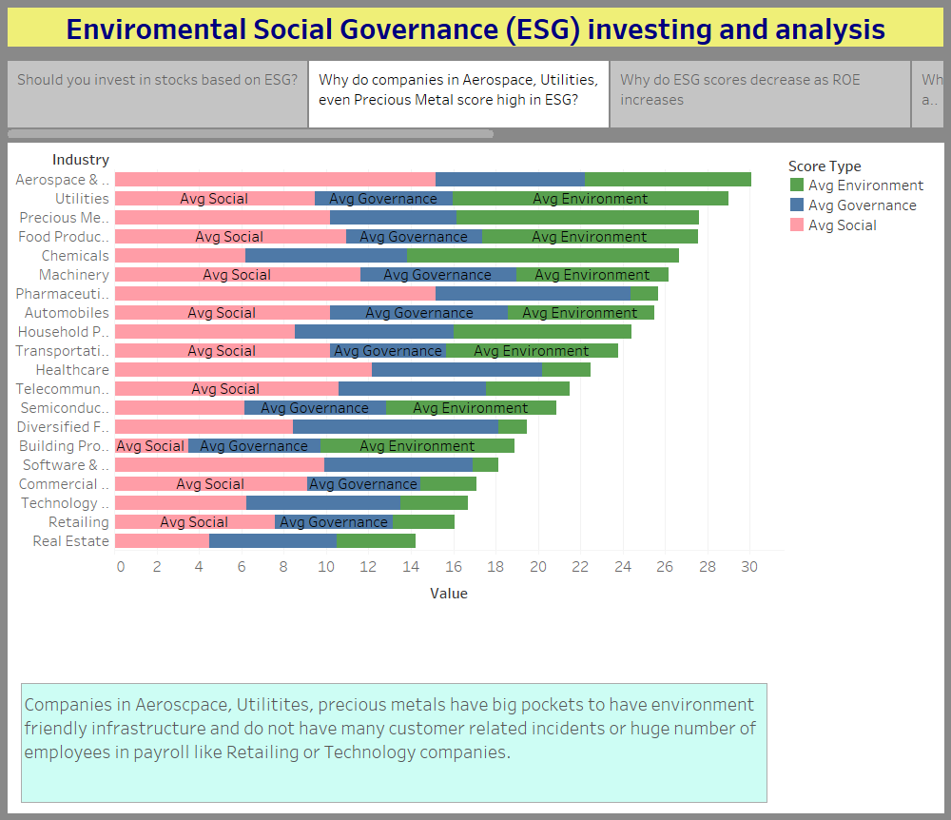
Notes:
Deliverable: Demo of interactive dashboard
Presenter: Monica
Call out: if Demo doesn’t work - continue via next 5 slides
Speaker Notes: see demo

Slide 28
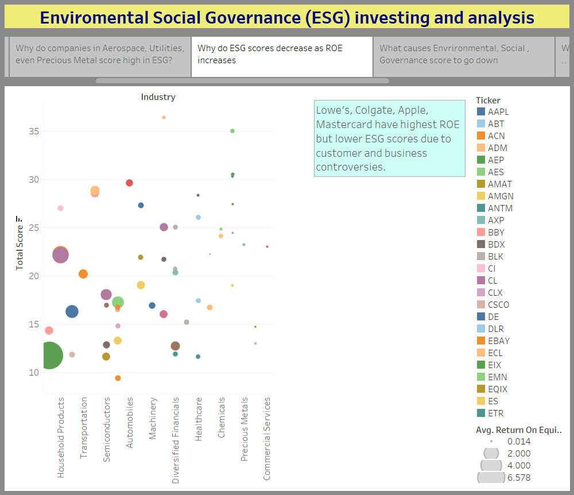
Notes:
Deliverable: Demo of interactive dashboard
Presenter: Monica
Call out: if Demo doesn’t work - continue via next 5 slides
Speaker Notes: see demo

Slide 29
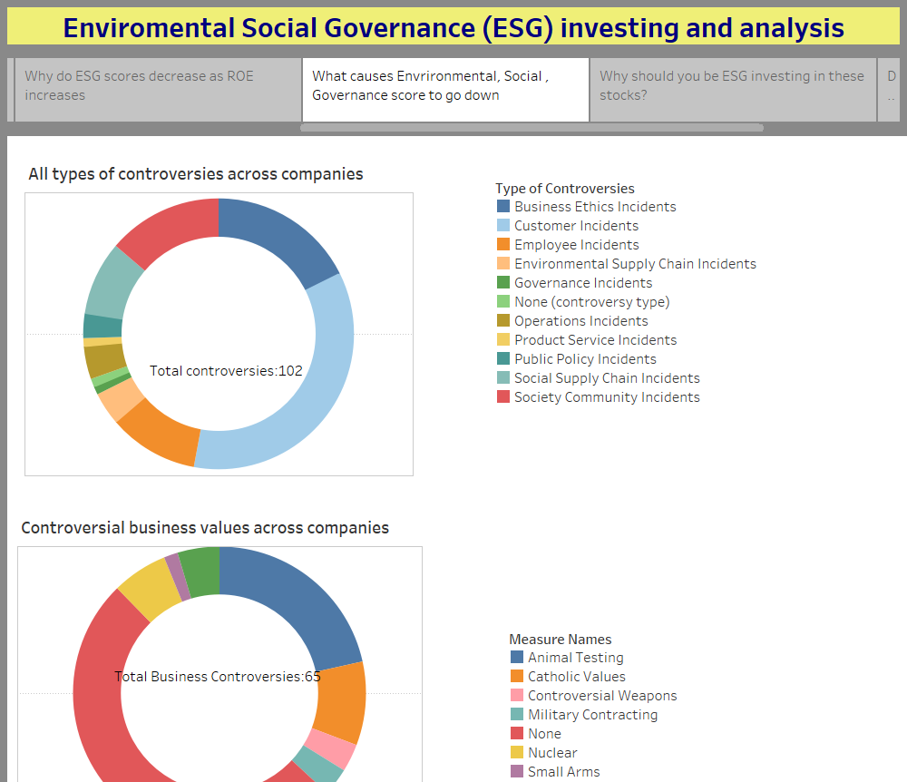
Notes:
Deliverable: Demo of interactive dashboard
Presenter: Monica
Call out: if Demo doesn’t work - continue via next 5 slides
Speaker Notes: see demo

Slide 30
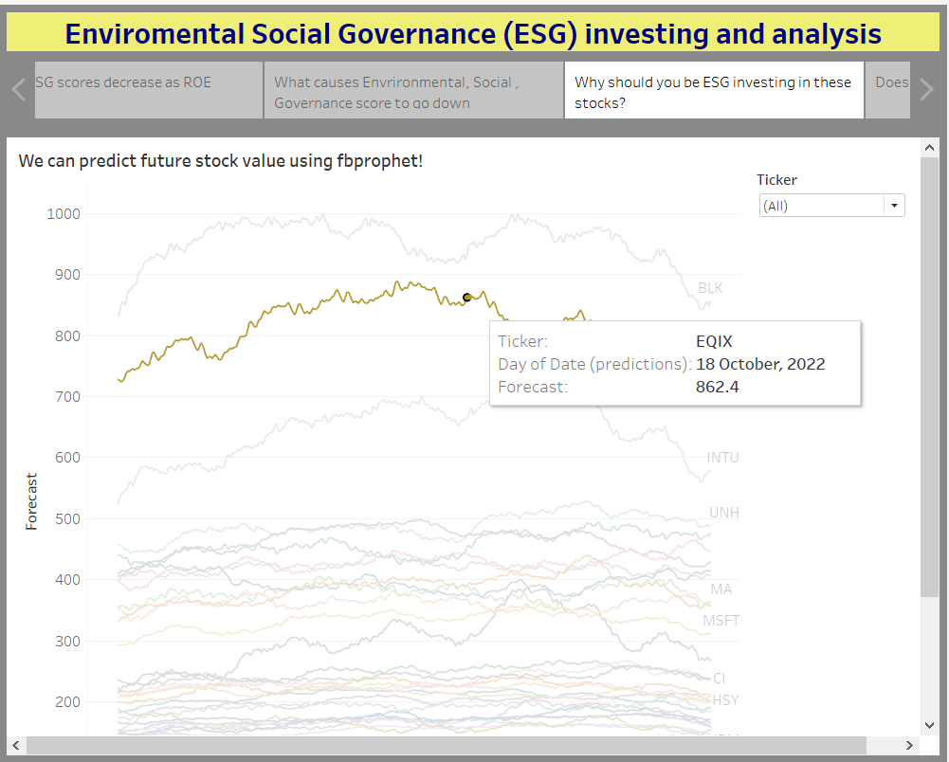
Notes:
Deliverable: Demo of interactive dashboard
Presenter: Monica
Call out: if Demo doesn’t work - continue via next 5 slides
Speaker Notes: see demo

Slide 31
Summary & Next Steps
Our Team
Our Journey
Our Sources
Our Q&A
Notes:
Time check: 7:40
Deliverable: Recommendation for future analysis
Presenter: Monica
Speaker Notes:

Slide 32

Our Team
Sachin Nabar: Database Administrator
Sucharita Bhattacharjee: Lead Analysis
Yicong (David) Luo: Machine Learning Specialist
Monica Dodds: Visualization
Notes:
Time check:
Deliverable: Recommendation for future analysis
Presenter: Monica
Speaker Notes:
Note: Imaginary titles are based on roles taken during our presentation.
Teamwork went into every step of process so all members could contribute to all aspects of the project.

Slide 33
Our Journey
Week 1
Week 3
Future Goals
Week 2
Weeks 4 & 5
Gather data
Initialize DB & ML models
Finalize DB integration
Finalize ML models
Draft dashboard & presentation
Reduce MAPE
Explore other models
Perform periodic DB refreshes
3/20/22
4/14/22
3/15/22
3/27/22
TBD
Finalize data
Establish Database Connectivity
Begin Machine Learning
Finalize ML models
Integrate ML & DB into Dashboard
Notes:
Time check:
Deliverable: Recommendation for future analysis
Presenter: Monica
Speaker Notes:
Deliverable: Recommendation for future analysis
To reduce MAPE on predictions using hyperparameter tuning on each stock.
To checkout ARIMA. LSTM Models for better performance
To update the tables periodically in future as data changes and have a database of historical ESG data.

Slide 34
References
https://www.investopedia.com/terms/e/environmental-social-and-governance-esg-criteria.asp
https://ca.finance.yahoo.com/
https://www.forbes.com/just-companies/#5d410d762bf0
https://en.wikipedia.org/wiki/Environmental,_social_and_corporate_governance
https://ecyy.medium.com/forecasting-by-fb-prophet-in-colab-c9d4db2d4195
https://www.analyticsvidhya.com/blog/2021/07/stock-prices-analysis-with-python/
https://www.alva-group.com/blog/what-is-an-esg-score-and-how-is-it-calculated/

Slide 35
Thank you.

